Slide 1
Global PSP Project for Indian Embassies and Consulates
Quick Guide – Head of Consular Wing (Role: MissionHead) Users

Slide 2
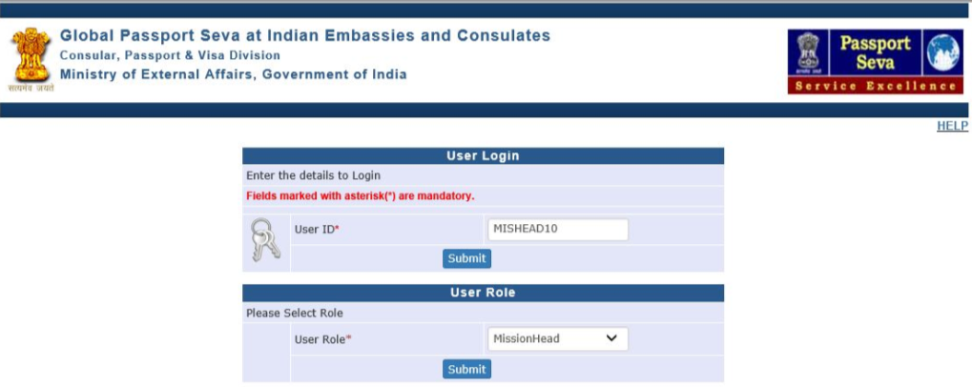
Login Using User ID, Password, and Grid Values
Visit Global PSP Office Portal (https://embassy.passportindia.gov.in)
Enter User ID
Press Submit button
Choose User Role as ‘MissionHead’ (for Head of Consular Wing users)
Press Submit button displayed below the User Role

Slide 3
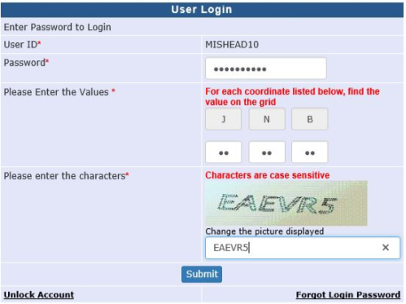
Login Using User ID, Password, and Grid Values (continued..)
Enter Password
Check your User Grid and enter the values for the three alphabets displayed on the screen
Enter the characters displayed in the CAPTCHA image
Press Submit button

Slide 4
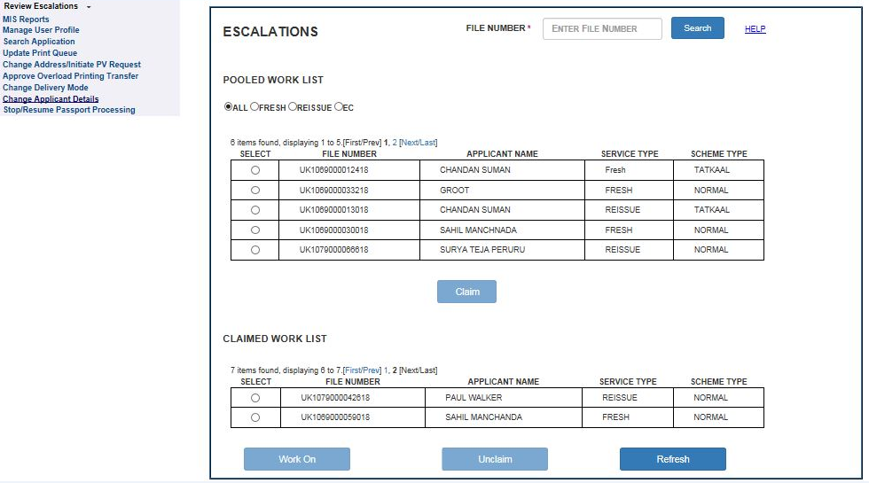
Review Escalations screen
Click on the link Review Escalations
Select file from Pooled /Claimed work-list and press Work On button

Slide 5
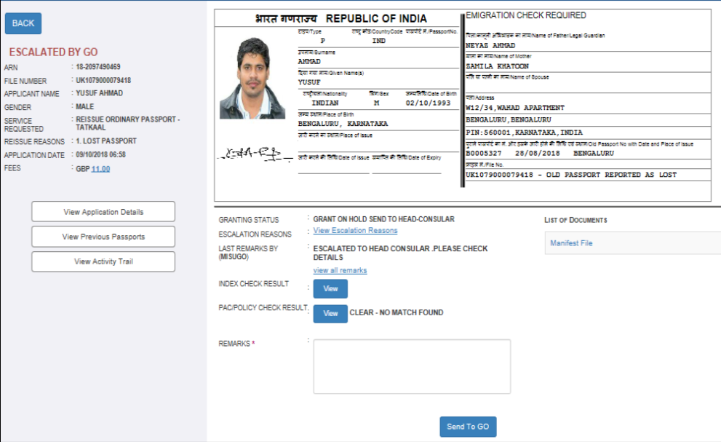
Review Escalations screen (continued..)
Details of the application and option to send back to respective users (‘GO’ in the sample screenshot below) is displayed

Slide 6
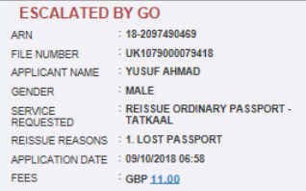
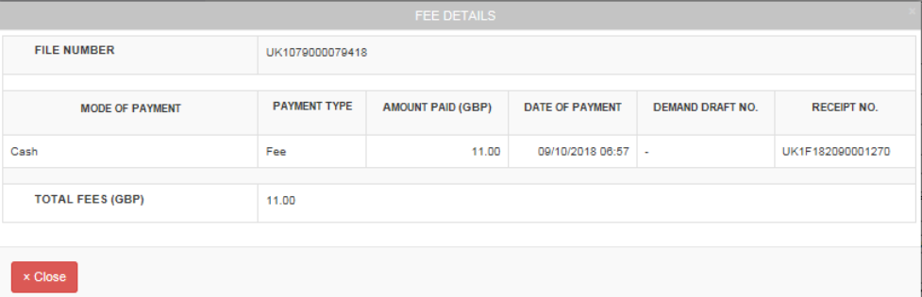
Review Escalations screen (continued..)
Click on the Fee Amount (displayed as hyperlink in Review Escalations Work On screen) to view Fee Details

Slide 7
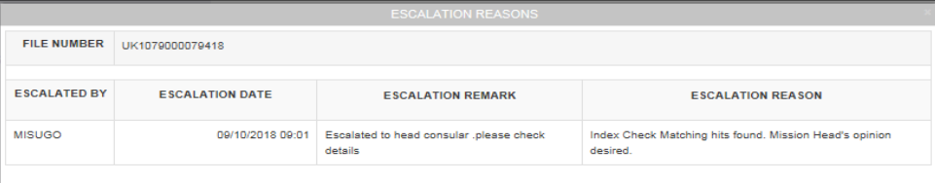
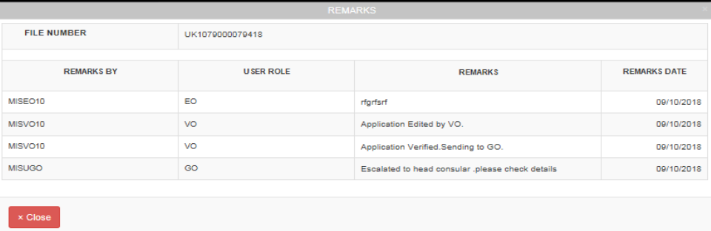
Review Escalations screen (continued..)
Click on the View Escalation Reason hyperlink (to view the reason for escalation) and View All Remarks hyperlink (to view all processing remarks) in the Review Escalation Work On screen

Slide 8

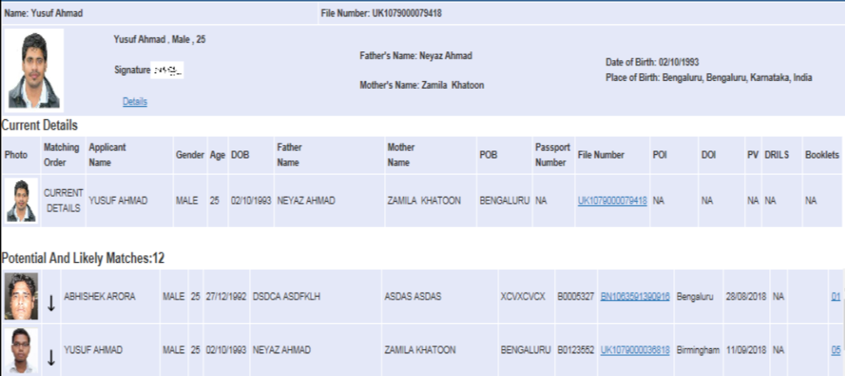
Review Escalations screen (continued..)
Click on the View button displayed alongside the Index Check Result field to view the results of Index Check

Slide 9
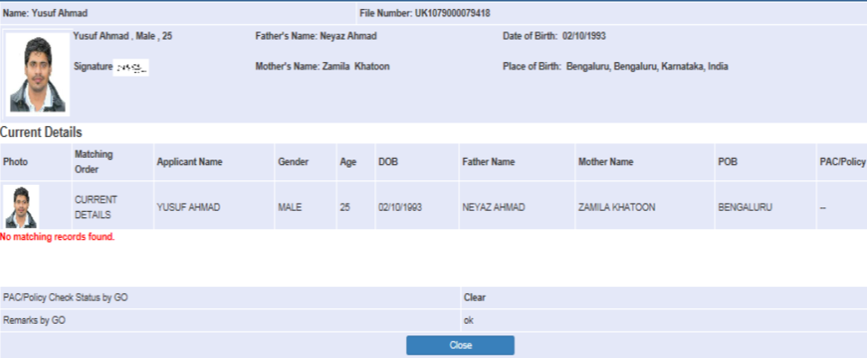
Review Escalations screen (continued..)
Click on the View button displayed alongside the PAC/Policy Check Result field to view the results of PAC/Policy Data Check

Slide 10

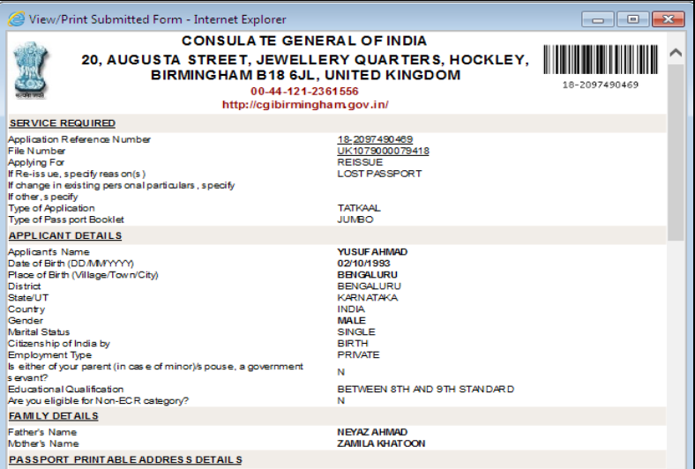
Review Escalations screen (continued..)
Click on View Application Details button in the Review Escalations screen to view the application form details

Slide 11

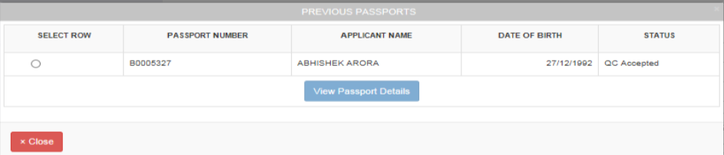

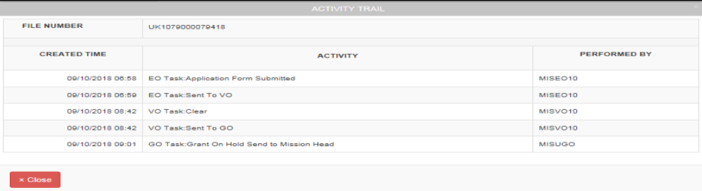
Review Escalations screen (continued..)
Click on View Previous Passports and View Activity Trail buttons in Review Escalation screen to view respective details

Slide 12
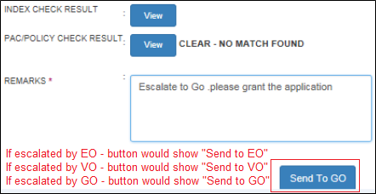
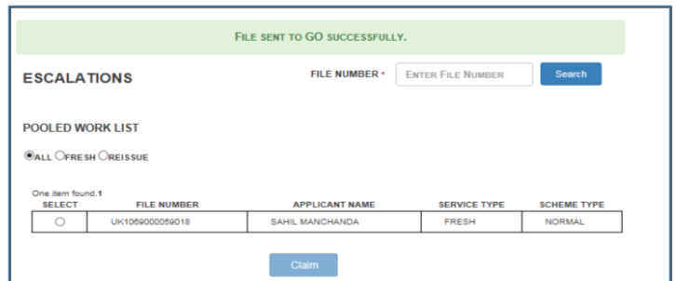
Review Escalations screen (continued..)
Click on the “Send to <EO/VO/GO>” button to send back to the pool of users (EO, VO or GO) which escalated the case to you (Head-Consular user) after entering due remarks

Slide 13
In case of additional information or clarification, please contact Global PSP Support Team at
Email : global.psp@tcs.com
Phone : +91-0120-672-9595/96
Mobile : +91-730-351-9595
Thank You

